Slide 1
Getting Started
CS771: Introduction to Machine Learning
Purushottam Kar

Slide 2
An overview of ML
Study similarity of ML with a student preparing for an exam
Look at a toy ML problem
Learn what is training data, test data?
Learn what is a model?
Warning: lots of oversimplifications ahead!

Slide 3





A typical study cycle (e.g. in a course)
TEST
TEST
TEST
Preparation
Practice Tests/Study Material
Actual Exam
EXAM
Subject Knowledge
Pass / Fail

Slide 4







Spam Filtering
Suppose Mary has already tagged several old emails as spam/non-spam, can we tag her new emails too?
Trick: use the old tagged emails to try and understand what sort of emails does Mary think of as spam and which as non-spam!
E.g. may find that emails about shopping always tagged as spam
E.g. may find that emails from Jill are never tagged as spam
These insights/patterns are what are stored in the spam filter
Our spam filter helps us make predictions on new emails

Slide 5





A typical ML workflow
ML Algorithm
Ah! That is the fun (and artistic) bit about ML. We will learn tons of ways on how ML algos store patterns
Old Emails
The spam filter stores information about your personal preferences about what looks spam to you
New Emails
How is this information stored?
Spam Filter
Spam/Non-spam

Slide 6
A typical ML workflow
ML Algorithm
Training Data
Test Data
Model
Output

Slide 7

ML as an “examination”
Our brain stores subject matter
Use subject matter to solve exam
Critical to do well on exam-day
Mock test results indicative
No out-of syllabus questions
Should not leak exam paper before exam
The model stores data patterns
Use model to predict on test data
Critical to do well on test data
Training accuracies indicative
Training/test data are similar
Should not look at test data while training

Slide 8
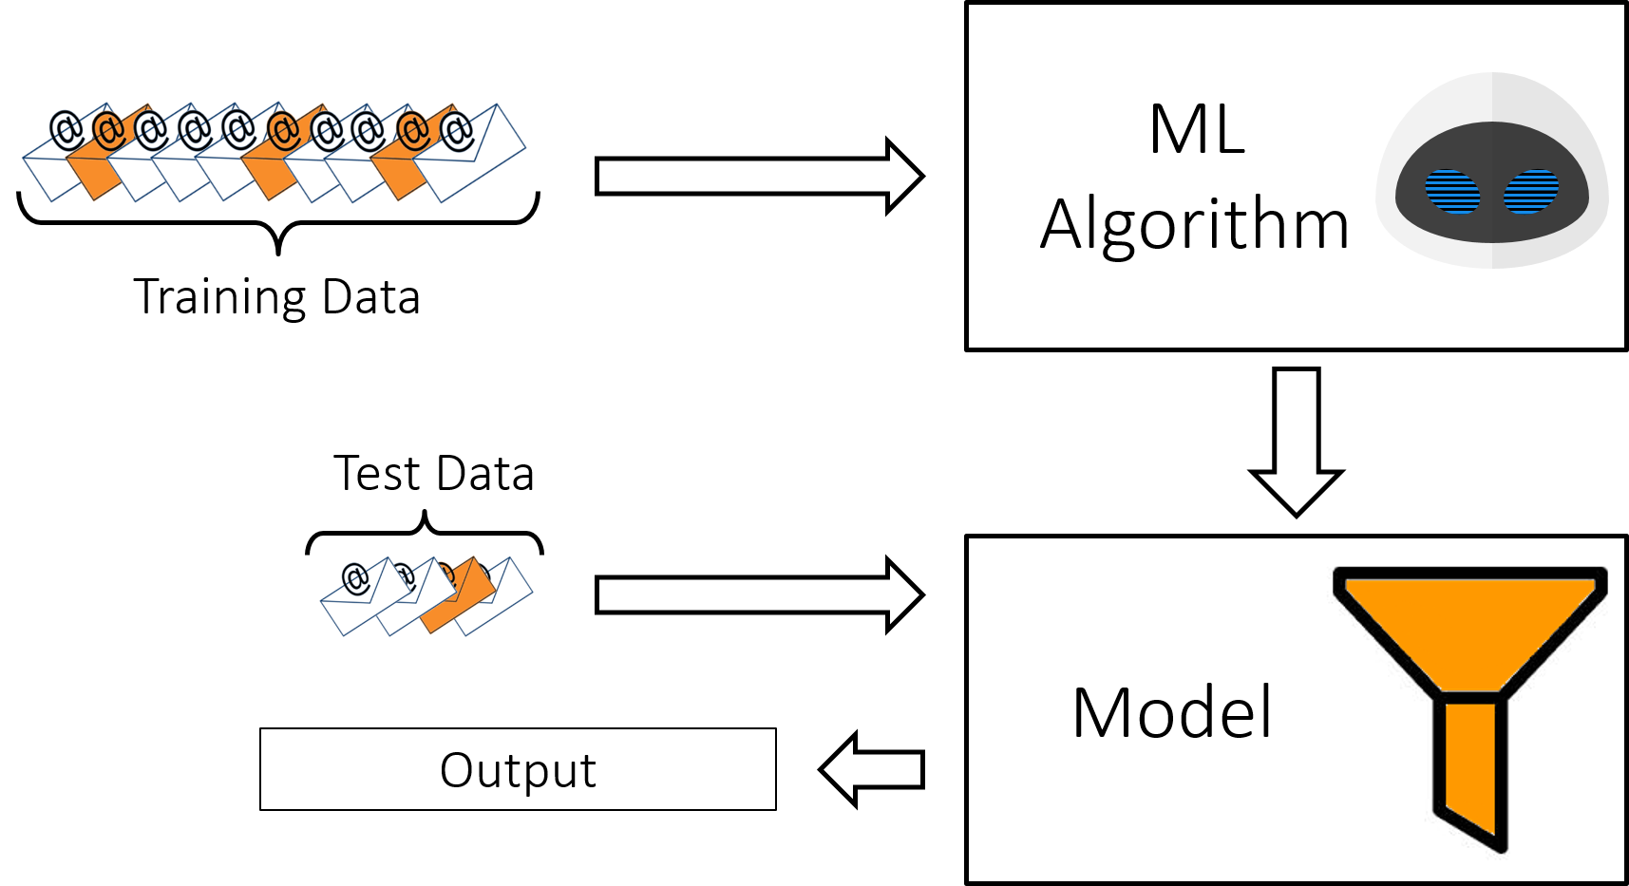
A typical ML workflow

Slide 9








ML can do lots of cool things with test data
In this course, we will learn how to do most of these operations with test data
Test Data
Regression
Multi-classification
Clustering
URGENT, OFFICIAL, TAX
Tagging
Binary Classification
Ranking
$$>$$
$$>$$
$$>$$

Slide 10
A typical ML workflow

Slide 11
ML can take in lots of kinds of training data
We wont be able to cover all these training settings in this course – there are entire courses devoted to specific training settings e.g. CS773 (Online Learning)
Training Data
Batch Learning
Active Learning
Robust Learning
Supervised Learning
Semi-supervised Learning
Online Learning
Unsupervised Learning
Reinforcement Learning

Slide 12
A typical ML workflow

Slide 13

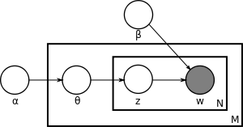

ML can store info in lots of innovative ways
ML Models and Algorithms
Linear/Opt
Local
Neural/Deep
We can mix-n-match these methods too e.g. Bayesian Deep Learning or Kernel Nearest Neighbours (Local)
We will learn how to use each of these techniques in the course, but a bit briefly. As before, there are entire courses devoted to each technique e.g. CS772 (Prob ML), CS774 (Opt)
Probabilistic/Bayesian
Kernel
Correct! But we will not be able to cover such advanced methods either

Slide 14
Fantastic Features
… and how to find them
What are vectors
How are vectors used in ML
Useful operations on vectors

Slide 15


What are features
Why did we not keep the word “to” as a feature?
We could have – but it does not carry much information about spam/non-spam since it is such a common word!
Features are a way for us to give input to ML algorithms
Most ML algorithms use numerical vectors to represent features
For example, in spam classification, every old email (training data) as well as every new email (test data) must be converted into a vector
Guys, something is wrong with our feature. The word “do” means different things in two emails
Do | You | Want | Go | Million | Dollars | Dinner | Today
1 | 1 | 1 | 1 | 0 | 0 | 1 | 0
1 | 1 | 1 | 0 | 1 | 1 | 0 | 0
1 | 0 | 0 | 0 | 1 | 0 | 0 | 1
Do you want to go for dinner?
Do you want to win a million dollars?
I have a million things to do today!
Since I am basically a computer program, I need you to convert your data into a nice set of numbers
Good catch – this may not be the best feature representation!

Slide 16
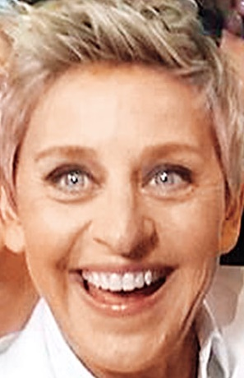

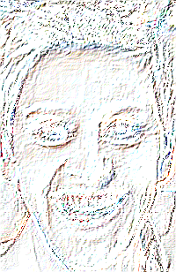

What are features
May represent images as a vector/matrix of pixel RGB values
May instead encode images using edges present in them
May instead encode images using presence of eyes/noses/ears
Makes sense. Features are also a way for us to store what we know about data. If we throw away data, naturally doing anything becomes hard!
Raw/ Low-level features
Derived/ High- level features
If your features are good, my job becomes twice as easy. If not, then doing any ML may become impossible!

Slide 17



Types of Features
Discrete numerical features often called ordinal features
Numerical Features
Categorical Features
Relational Features
Dangal
Dhoom 3
B’LORE
DELHI
KANPUR
A
B
AB
O
BTECH
MTECH
MS
PHD
$$>$$
$$>$$
$$>$$
Ranking in Class
Social Media

Slide 18

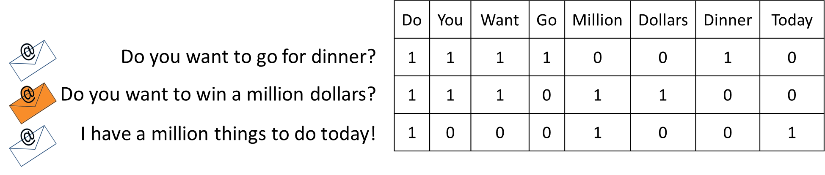
Derived Features
As we saw, the bag-of-words (also called BoW) is not always a very good feature (it confuses polysemous words). However, it is still extremely popular due to its simplicity
Bagged/binned features
Pooled/aggregated features
ESC101 (A), ESO207 (B), CS220 (B), CS340 (C), MSO201 (A), CS771 (A)
A B C D E F
ESC101 (A), ESO207 (B), CS220 (B), CS340 (C), MSO201 (A), CS771 (A)
10 (max), 8.67 (avg)
The way we represented emails in the spam problem is called the bag-of-words feature

Slide 19


Feature Selection??
Useful for predicting expenditure
DIET (VEG/NON-VEG)
Not useful for predicting expenditure
EYE COLOR
TOTAL INCOME
EDUCATION LEVEL
FAMILY SIZE
HOUSE NO (ODD/EVEN)
NO OF CHILDREN
In fact, one reason for the success of deep learning is that it learns good features themselves!
RENTED/SELF OWNED
(EXPENDITURE)
SURNAME LENGTH
Can we perform automatic feature selection?
Yes indeed, but those methods are a bit advanced for now!
True, but more on deep learning later! For now, back to basics.

Slide 20
A bit of caution with features
Tricks, mnemonics lessen cognitive load, increase speed
Easy questions can be solved in one step with a mnemonic!
Too many mnemonics can confuse you at time of exam
Derived features make learning easier, faster at test
What you are trying to predict is just another feature of the data!
Too many useless features can confuse classifier
However, not to worry. For most of this course, we will give you pre-made feature vectors ☺
In fact, one of the main challenges in deep learning is that it learns way too many features

